Slide 1
STOCK MARKET PREDICTION USING LSTM
By
UNDER THE SUPERVISION OF:

Slide 2
01
02
03
04
INTRODUCTION
IMPLEMENTATION
CONCLUSION
RESULT ANALYSIS

Slide 3
INTRODUCTION
01

Slide 4
INTRODUCTION
What is Stock Market?
A stock market is a public market for the trading of company stock.
Stock market allows us to buy and sell units of stocks of a company.
If the company’s profits go up,then we own some of the profits and if they go down,then we lose profits with them.
If more sellers than buyers,stock prices tend to fall.Conversely,when more buyers than sellers, stock prices tend to rise.

Slide 5
OBJECTIVE
Why Stock Market Prediction?
Stocks are very volatile; This complex nature of stock prices is a significant attraction for researcher and statisticians to find a way to predict them.
Despite the numerous amount of research publications in this field,there are still many that claim that stock markets cannot be predicted.
This is primarily because of the number of factors that affect stocks prices and those factors themselves depend on some other, potentially unknown factors.
And this is the motivation to work on this topic.
Notes:
There are numerous causes for this, including market volatility and a variety of other dependent and independent variables that influence the value of a certain stock in the market. These variables make it extremely difficult for any stock market expert to anticipate the rise and fall of the market with great precision.

Slide 6
APPROACHES TO PREDICT
Recurrent Neural Networks suffer from short-term memory. If a sequence is long enough, they’ll have a hard time carrying information from earlier time steps to later ones. So if you are trying to process a paragraph of text to do predictions, RNN’s may leave out important information from the beginning.
To accurately predict the future closing value of a given stock across a given period of time in future.
Using LSTM a special kind of RNN widely used for time series prediction.It can perform long term dependencies.
Notes:
EVEN IN MACHINE LEARNING THERE ARE LOTS OF WAY TO PREDICT THE STOCK PRICES.AMONG THEM LSTM IS THE BEST WAY TO FORECAST THE DATA

Slide 7
IMPLEMENTATION
02

Slide 8
WORKFLOW
1)INPUT DATASET
2)DATA PREPARATION
3)MODEL CONSTRUCTION
4)TRAINING
5)PREDICTION
6)RESULT ANALYSIS
AVAILABLE RAW INFORMATION
PREPARING THE RAW DATA AND MAKE IT SUITABLE FOR ML
LSTM MODEL
CONSTRUCTION
FITTING THE PREPROCESSED DATA
FORECASTING OF FUTURE STOCK PRICE BY THE MODEL
EVALUATION OF PREDICTED VALUES

Slide 9
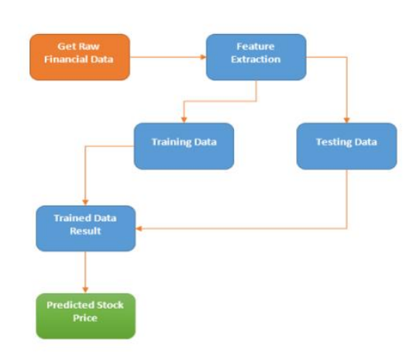
FLOWCHART
WORKFLOW
GATHERING DATA
FEATURE EXTRACTION
MODEL CONSTRUCTION
TRAINING AND TESTING
PREDICTION
EVALUATION

Slide 10
DATA PREPROCESSING
MODEL CONSTRUCTION
RESULT ANALYSIS
EVALUATION
TRAINING & TESTING
Usually dataset contains
noises,null values and some unwanted data.Removal of those data is done here
LSTM model is imported from the Keras a ML library
Since the data is time series, I will take the first 90% of data as training and the last 10% as test data Using the TimeSeriesSplit.
The predicted data is visualized and compared with the actual data.
Predicted data is evaluated by evaluation metrics such as R2-Score,MSE.

Slide 11
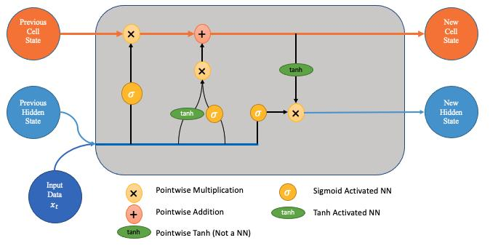
LONG SHORT TERM MEMORY
Long Short-Term Memory is one of many types of Recurrent Neural Network RNN, it’s also capable of catching data from past stages and use it for future predictions . In general, an Artificial Neural Network consists of three layers:
1) Input layer,
2) Hidden layers,
3) Output layer.

Slide 12
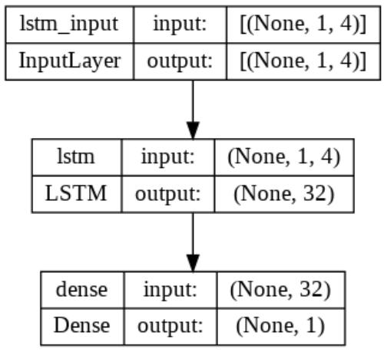
WHY LSTM?
LSTM is one type of recurrent neural network which is used to learn order dependence in sequence prediction problems.
Due to its capability of storing past information, LSTM is very useful in predicting stock prices. This is because the prediction of a future stock price is dependent on the previous prices.
Notes:
LSTM has feedback connections. It can handle single data points (such as pictures) as well as full data sequences (such as speech or video).

Slide 13
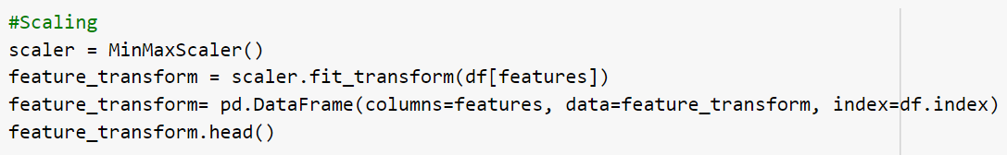
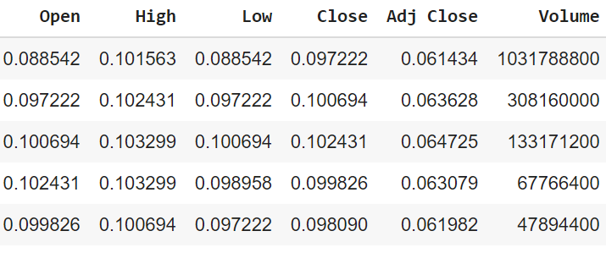
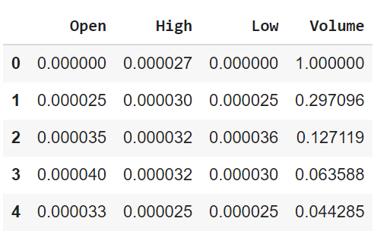
SCALING
Notes:
To decrease the computational cost of the data in the table, we will scale the stock values to values between 0 and 1. As a result, all of the data in large numbers is reduced, and therefore memory consumption is decreased. Also, because the data is not spread out in huge values, we can achieve greater precision by scaling down. To perform this we will be using the MinMaxScaler class of the sci-kit-learn library.

Slide 14
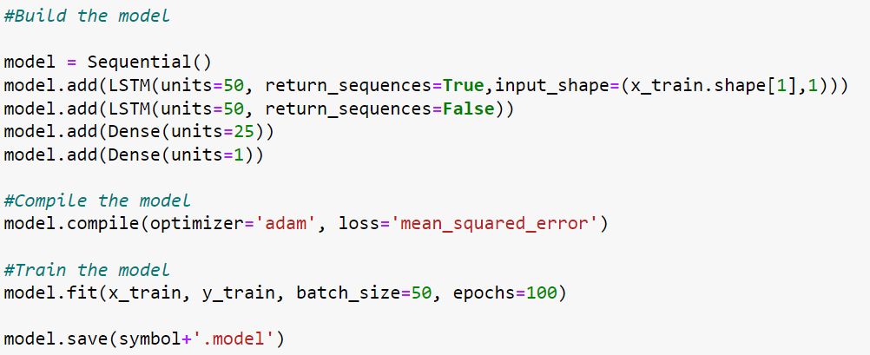
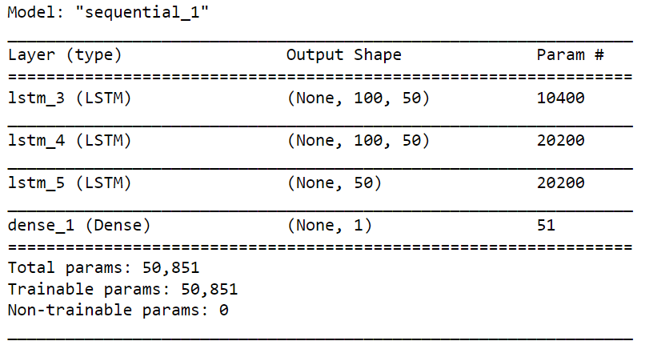
MODEL BUILDING
Model Summary
Notes:
input the data into the LSTM model. Before we can do that, we must transform the training and test set data into a format that the LSTM model can interpret. As the LSTM needs that the data to be provided in the 3D form, we first transform the training and test data to NumPy arrays and then restructure them to match into the format

Slide 15
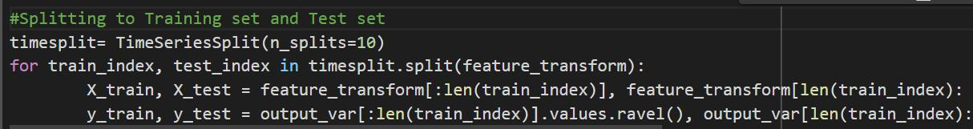
MODEL TRAINING & TESTING
Since the data is time series, I will take the first 90% of data as training and the last 10% as test data.Using the TimeSeriesSplit I am splitting it into two divisions
After fitting the data with our model I use it for prediction.This is the
Actual prediction of LSTM on APPLE dataset with 99% accuracy.
MSFT dataset training and fitting is given below

Slide 16
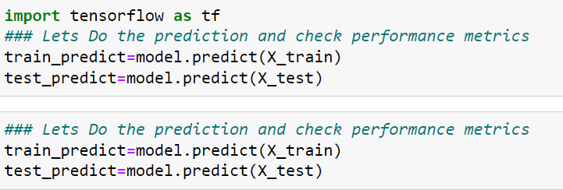
Model fitting and testing of APPLE Dataset.Here the training and testing data are fitted in the model.
After model fitting using the x_train and x_test we are predicting the value of future stocks.

Slide 17
RESULT AND ANALYSIS
03

Slide 18
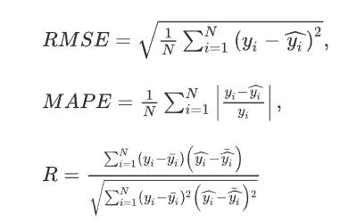
EVALUATION
Prediction accuracy and reliability of these models are assessed by calculating three different performance metrics —RMSE, MSE, and R2_SCORE. The analytical form of these metrics are defined as follows:

Slide 19
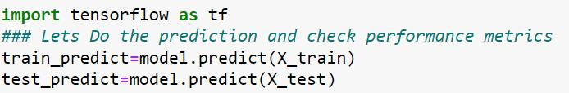
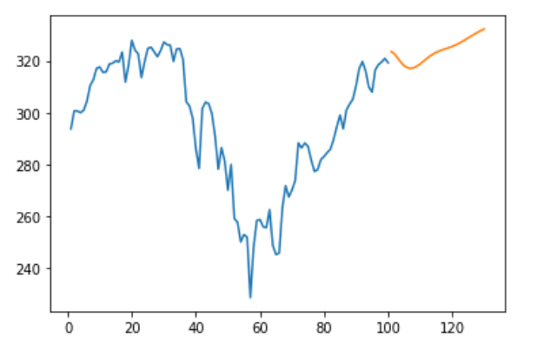
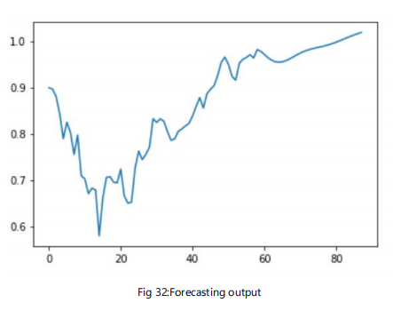
This is the forecasted data of APPLE dataset.
The orange line shows the closing stock value of next 30 days.

Slide 20
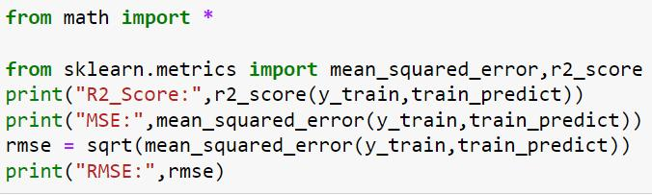

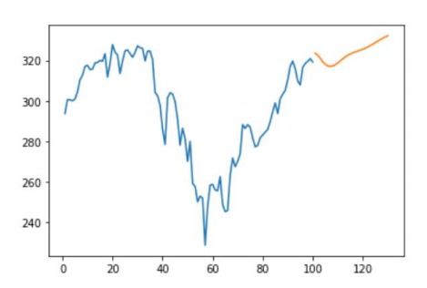
R-squared is a statistical measure of how close the data are to the fitted regression line.
The MSE is the mean of the squared differences between actuals and predictions.

Slide 21
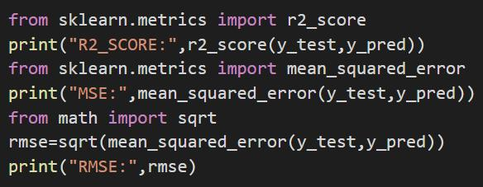
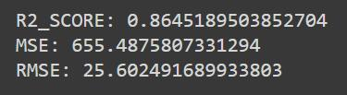
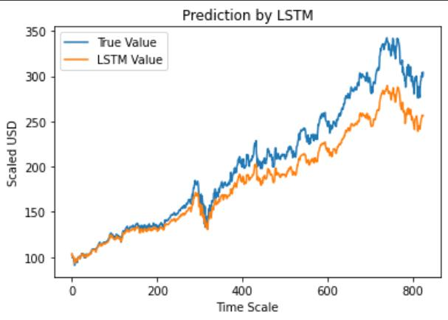
This the actual prediction of MSFT dataset.

Slide 22
CONCLUSION
04

Slide 23
CONCLUSION
With the introduction of Machine Learning and its strong algorithms, the Stock Market Prediction advancements have begun to include such approaches in analyzing stock market data.
This project proposes RNN based on LSTM built to forecast future values for both MSFT and APPLE assets, the result of our model has shown some promising result. The testing result confirm that our model is capable of tracing the trends of stock market.

